Slide 1
The Baldrige core values – sometimes underappreciated, never irrelevant, always helpful!
Dr. Jeffrey Weinrach
Senior Process Improvement project Manager, LOBO Quality Improvement Process Team, UNM Medical Group
July 20, 2022
Notes:
Facilitator notes: Just the introductory slide
We should all be here for the Process mapping class

Slide 2
“The Baldrige Health Care Criteria build on core values and concepts…”
What does this really mean?
How are the Criteria built on core values and concepts?
What does this look like (effectively) in action?
Notes:
Facilitator notes
Read slide

Slide 3
Baldrige Health Care Core Values
Systems Perspective
Visionary Leadership
Patient-Focused Excellence
Valuing People
Agility and Resilience
Organizational Learning
Focus on Success and Innovation
Management by Fact
Societal Contributions and Community Health
Ethics and Transparency
Delivering Value and Results

Slide 4
My first reactions when I learned the Core Values
Why are there no questions?
If they’re so important, why are they in the back of the book?
As an Examiner, what happened to being non-prescriptive/ non-judgmental??? Look at all the “should’s” and “must’s”!!!
Just do this – what’s the problem?
Notes:
Facilitator notes
Read slide

Slide 5
“Core Values”
They’re really more like a common set of best practices of high performing organizations – aren’t they?
Organizations often have their own core values or something similar – this could be confusing especially to organizations just starting with the Baldrige Framework.
The detailed verbiage doesn’t necessarily sound like “values” language.
Whether you believe this is the best name for them, accept it and make sure to distinguish them with the organization’s core values, beliefs, etc.
Notes:
Facilitator notes
Read slide

Slide 6
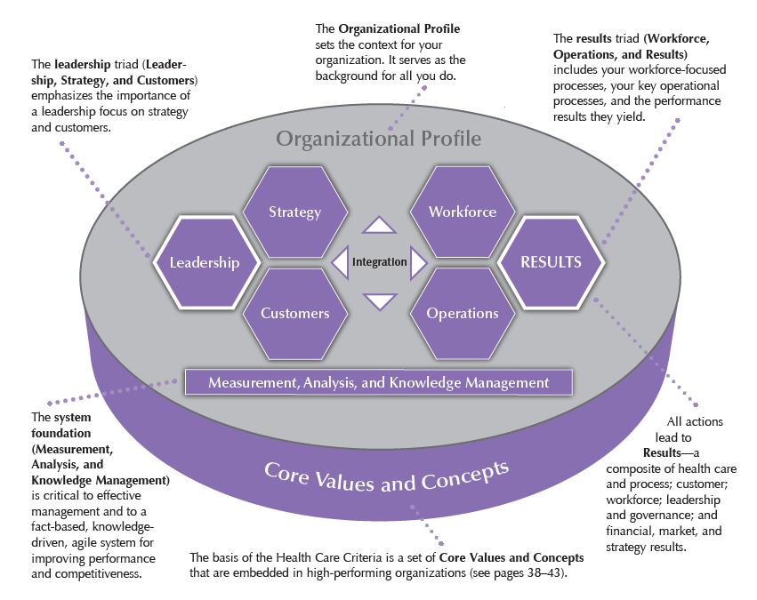
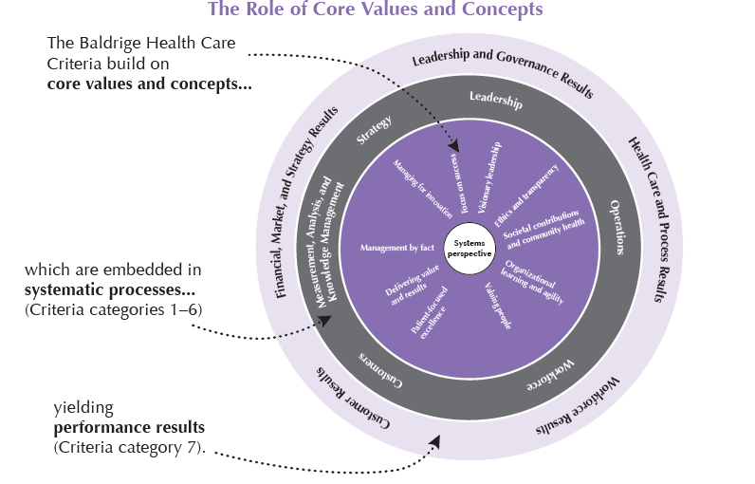
Core Values Views

Slide 7
Core Values are Foundational!
Some organizations start their “journey” focused on the core values rather than the Organizational Profile.
If high-performing organizations have these in common, it would seem like a reasonable starting point to consider them.
It’s easy to overlook them as they are a few pages compared with the Items/Categories, which are many more pages and tend to be more emphasized in training for both applicants and Examiners.
Notes:
Facilitator notes
Read slide

Slide 8
How should organizations incorporate Core Values into their overall Baldrige Performance Excellence strategy?
Ask the question throughout the organization (both at a high level and at a unit/department level): Which core values are we clearly aligned with, and which ones are not clearly evident?
As the Items/Categories are being addressed, consider the core values as a check or as illustrative examples.
Look for Core Values in the Key Themes/Executive Summary of Feedback Reports, and consider their implication and how to address them.
Notes:
Facilitator notes
Read slide

Slide 9
Systems Perspective – the “mother” of all the Core Values
All the Core Values are appropriate to consider, but there’s a reason why the Systems Perspective is the hub in the “Baldrige Wheel.”
Everything in the Framework ultimately relates to systems and system effectiveness.
In the early stages of the Baldrige journey, many organizations don’t have many of the key processes, let alone systems.
It’s reasonable to be thinking about systems even if it’s going to take some time to build them and improve their effectiveness.
Notes:
Facilitator notes
Read slide

Slide 10
Conclusions
Core Values truly are underappreciated and yet they are so critical.
Even in the Baldrige Framework, quantity (i.e., # of pages) doesn’t always correlate with quality!
Whether the Core Values are near the front of the book or in the back with the glossary of terms (also often underappreciated!), it’s important to read and understand the entire book from cover to cover!
As always, stay the course, run the race, keep the Core Values in mind, and remember that it’s a journey, not a destination!
Notes:
Facilitator notes
Read slide

