Slide 1

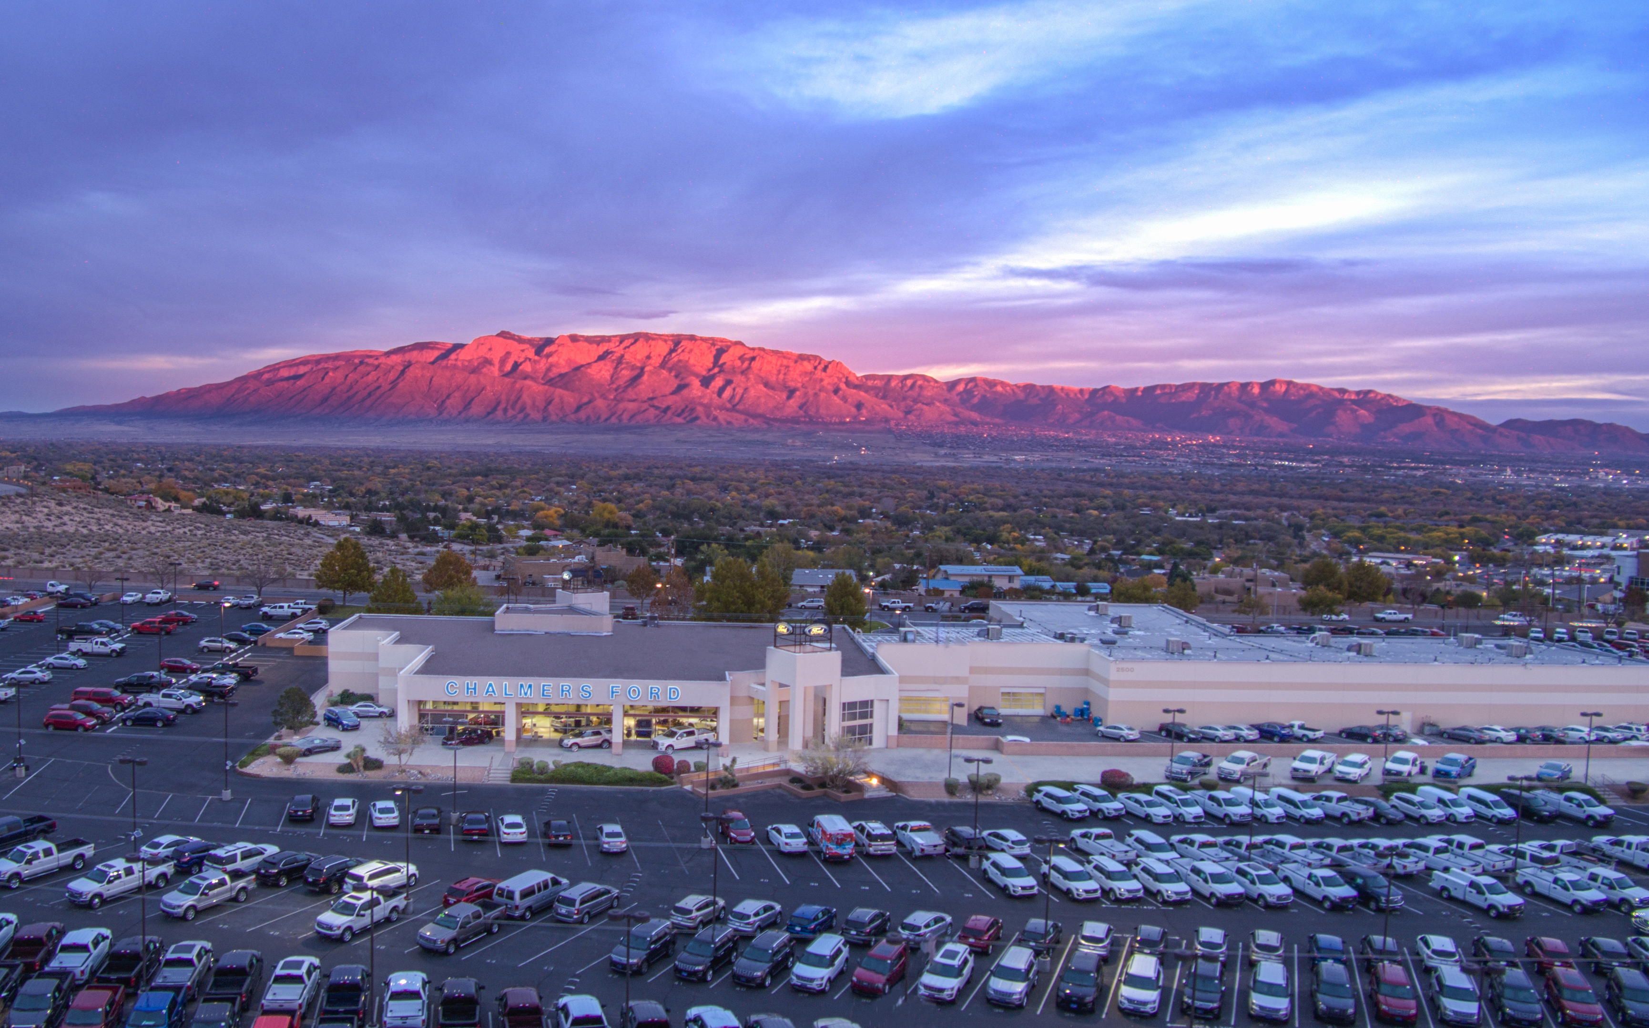
QNM
Andy Strebe
General Manager

Slide 2
200 Employees – Privately Held Local Ownership
Largest New Vehicle Volume Dealer in NM – Retail/Commercial
Large Used Vehicle Volume
Top Sales and Service Customer Satisfaction in the State/Region
High Employee Engagement Scores and Retention
Onsite Health Care – LNP Staffed Daily
Self Insured for Health Care
New Mexico and Arizona Vehicle upfitting operations – serving the Western US

Slide 3
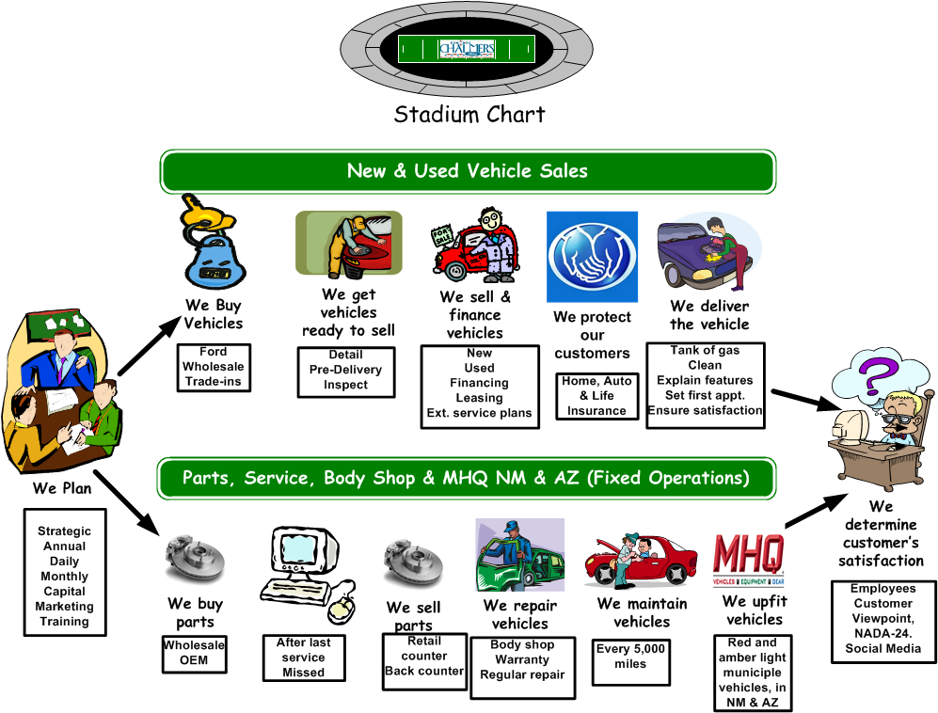

Employee Orientation
Notes:
Chalmers Ford

Slide 4
Our Vision
To be the Premier Ford Dealership in New Mexico
Long term employees, serving loyal customers, in a professional, ethical environment, with a pleasant atmosphere while actively partnering with our community)
Notes:
Vision is what we want to be in the future

Slide 5
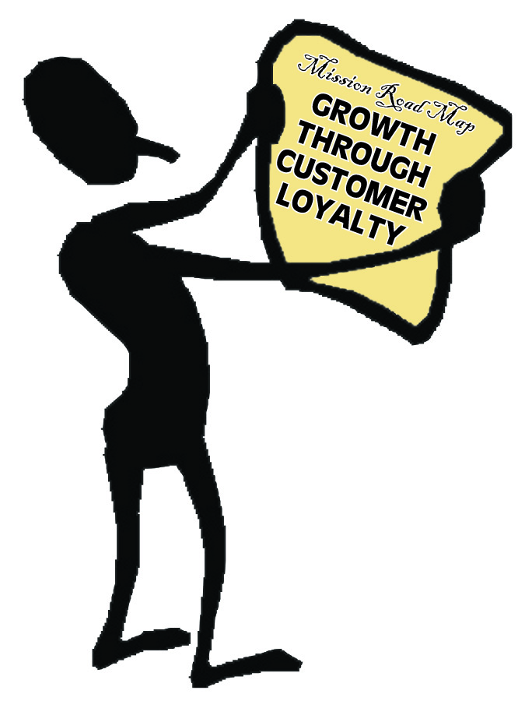

Our
Mission
Statement
Growth Through Customer Loyalty
Growth Through
Customer Loyalty
Notes:
Mission is how we will accomplish the Vision
Notice the focus on customer satisfaction
All employees make this happen

Slide 6
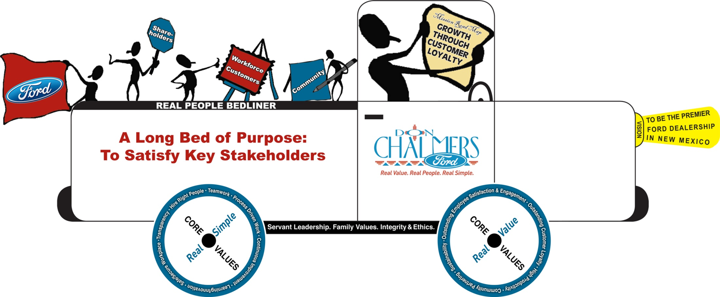
The Truck

Slide 7
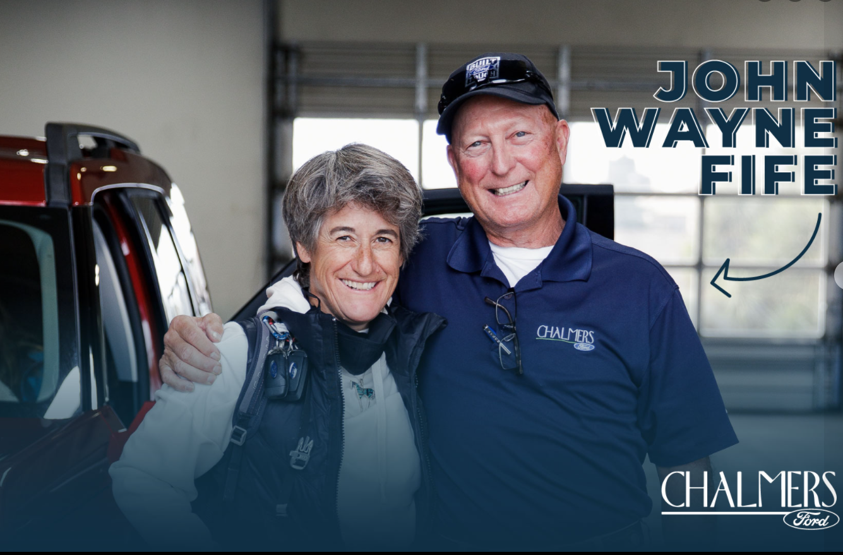

Slide 8
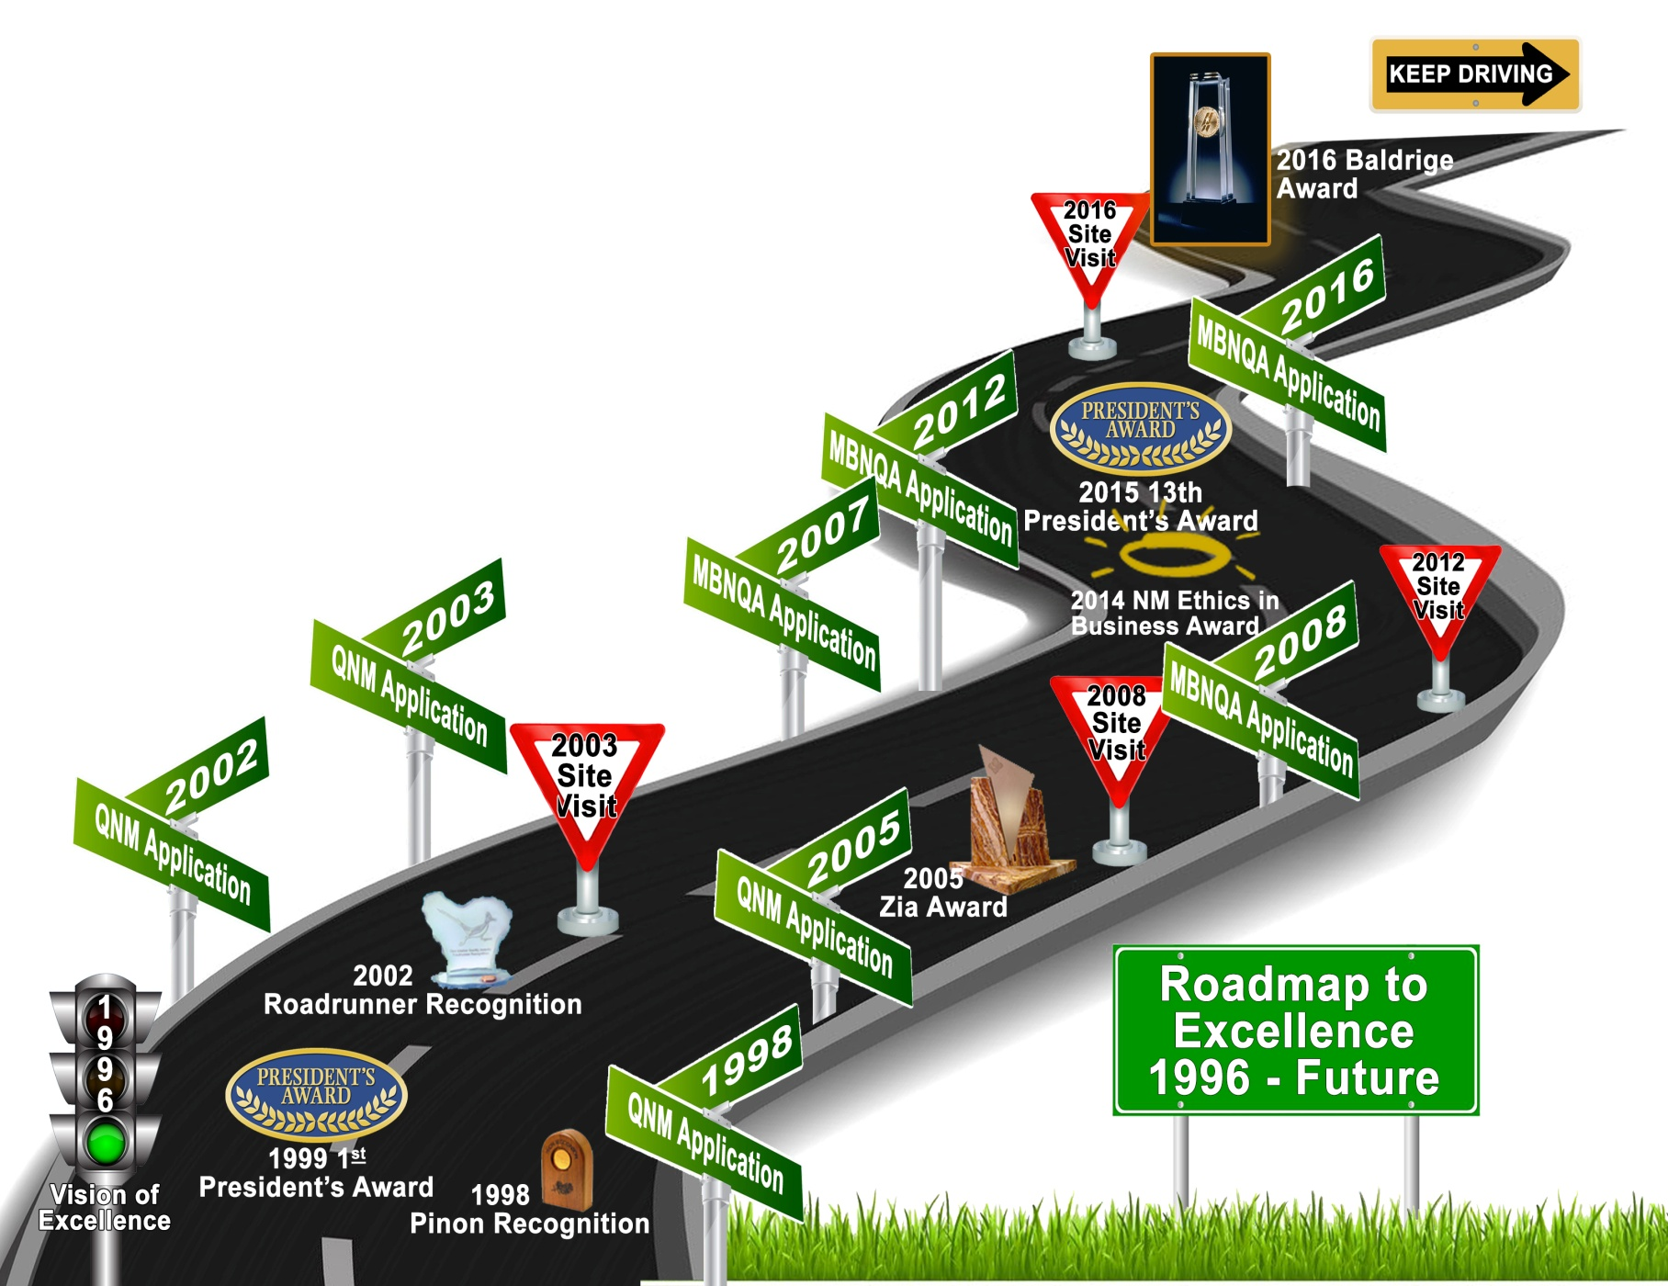




Our Journey… So Far
Notes:
The Journey: We learned that this Baldrige stuff works!
1996 vision to be outstanding, a different experience for customers. Visionary leadership, what car dealership aspires to be a world class organization? It’s typically all about making the most money for the guy whose name is on the building!
1998 We applied for roadrunner received the lower level, piñon . Mad , angry, they don't understand our business . Then we read the feedback report it was rich in information to help us get better. We were pissed off.
2001 we began working on documenting the key work processes to build consistency, train and measure process performance
2002 we applied for the Zia, the top award and won the roadrunner! Mad angry ...again…
2003 we applied at the Zia level and received a site visit. We received another roadrunner. we soon realized that maybe 10% -20% of our organization understood the baldrige model. We had significant gaps in deployment.
2005 we took a year off and worked on doing a no-kidding review of the Baldrige systems by tracking maturity levels, We received another site visit and Gosh darn it we were the 12th organization to win NM’s highest quality award, the Zia. So happy and so humbled by the experience. One of the key lessons learned, we had all of our senior leadership team become examiners for the state. Even Don did it. So off we go to the Baldrige award, we should have that puppy on the shelf soon.
2007 We took another year off to work on the ofis, applied to Baldrige and were not selected for a site visit.
2008 we applied and received the call that we were receiving a site visit. Oh my gosh, oh my gosh .... what happened in the fall of 2008?
401ks tanked, recession. And we became a not for profit organization, had we known we would have applied in the non-profit category. It's funny now but it wasn't so funny then.
You can decline a site visit. We thought about it but we were in it to improve. By the way there is a cost to host a site visit but Don felt it was a good investment in our quality journey and the overall sustainability of the dealership. Ford met with Don prior to the decision and shared that he had good news and bad news. Of all the rotten luck. We were getting a site visit and we were in a loss position. Don was very well respected at Ford, he was on many committees. A couple of weeks later our Ford regional manager showed up and handed Don a check for half of the site visit cost. We had a great experience and of course we did not win.
2012 we waited to apply again to come out of the recession and improve our key processes to get the results we wanted and felt we needed to win the award.
At the time Don was battling a rare form of cancer and was going through chemo. The experience brought so much life into him. We had another great site visit but came up short again. 75% of our process categories were in the 70-85 band. We were so disappointed and wanted it so bad for Don. Don said in our annual meeting that we won they just didn't give us the award.
Don passed away on Easter 2014. Shortly there after we received the Samaritan Counseling Centers ethics in business award. A car dealership.
We applied in 2016 and won the Malcolm Baldrige National Quality Award.
So what can you take away from this? : -We are slow learners -We didn't give up -We stayed the course -It made a huge difference in meeting our stakeholders requirements and expectations -With Dons passing you can see that the baldrige framework works, it's the greatest testimony to using Baldrige as your business model.

Slide 9
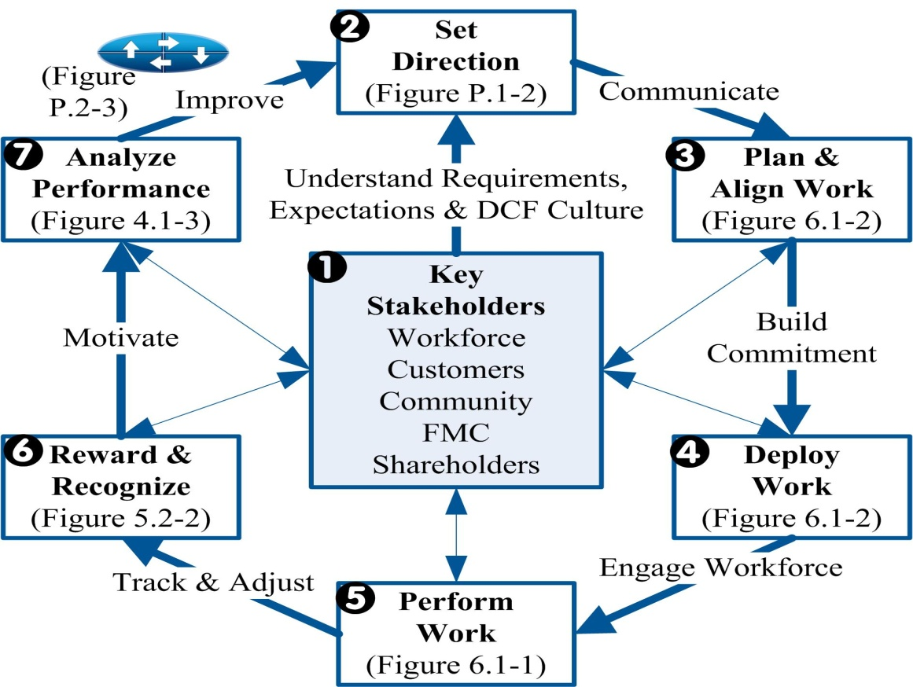
  Leadership System
Notes:
We have a fully deployed leadership system that has been through more than 5 cycles of our FORD improvement system, and it’s similar to most.
I’d rather build a truck with you today than walk you through the system.. Doesn’t that sound more fun?

Slide 10
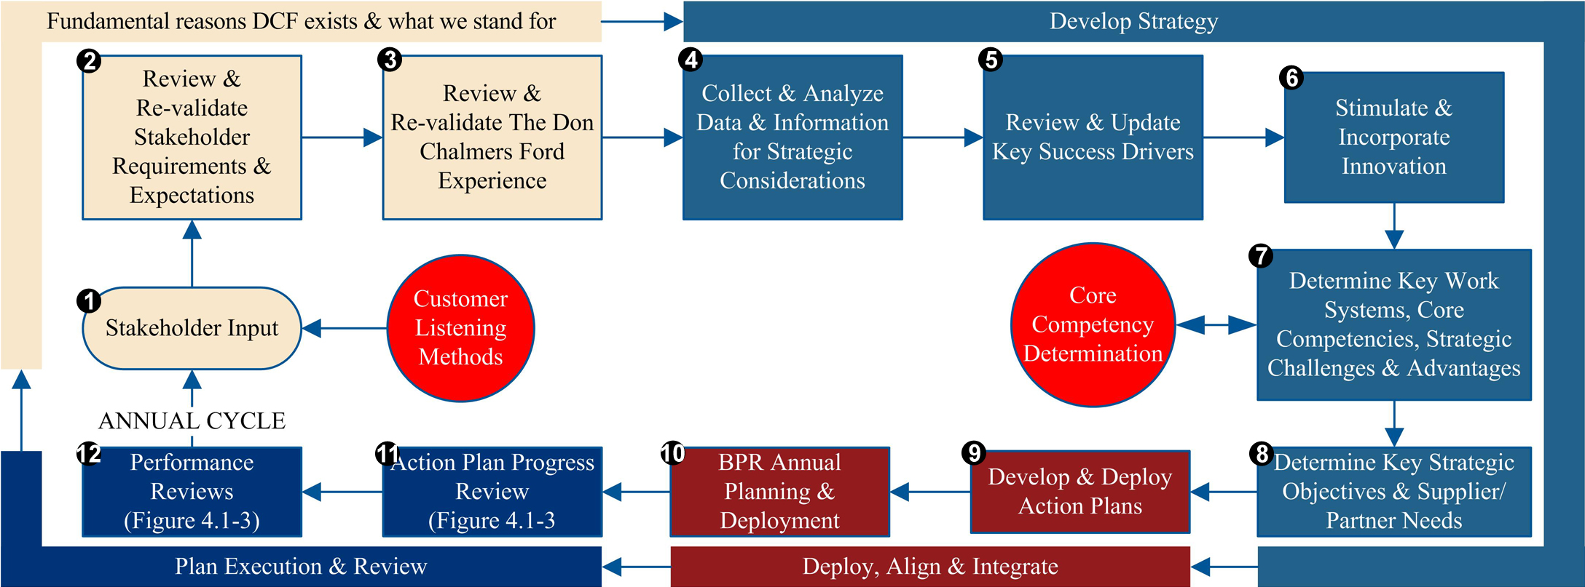
Strategic Planning System
Notes:
Gary, We have a System which was benchmarked with ProTech and tailored to our needs. We will talk about the 4 key stages:
The Fundamental Reasons we exist,
Develop the strategy
Deploying, aligning & integrating and
Executing and reviewing the plan.
Discuss hedgehog someone to make it continue, has to be form the top down, someone has to be the leader of the cats. Know the questions to ask.
Senior Leadership Team meets once a month on-site off-site with the addition of another sales manager that is not a senior leadership team member to bring another view. We share viewpoints . It’s not always easy to hear dissenting voices but it is critical to our success.
Minor versus major… correction and agile (purpose is to make agile corrections to our business not big course corrections
Need a culture of honesty, different opinions drive synergy.

Slide 11
Customer Communication & Response
We Listen
We Analyze
We Improve Performance
Strategic Plan
We Improve Design & Planning
We Improve Listening
Notes:
We improve through each step providing input into the Strategic Planning System.
-Key Work Systems & Processes
-Innovations from the latest technologies
-Learning & Development system gets changed due to this system
The entire system has been improved multiple times

Slide 12
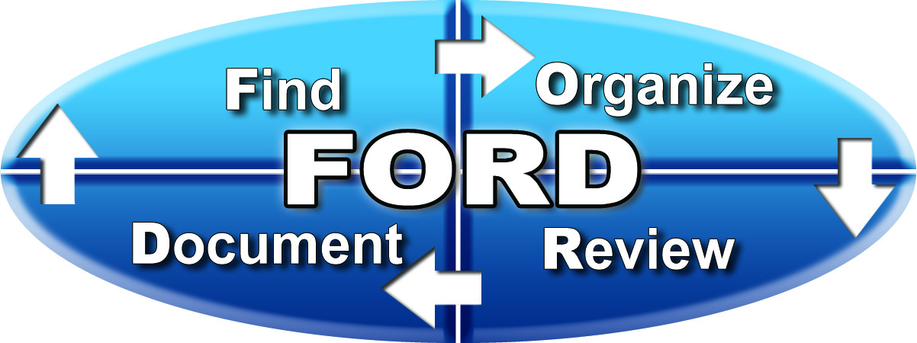
Measurement Analysis
Data & Information System
Sources
Select
Align & Integrate
Reviews
Ford
DOC/VOC
Y
Data DCF Needs?
Strategic / Annual Plan & BPRs
REY/REY
Financial
20 Group
N
Driving Forward
vAuto/TIM
Ends
Compliance
20 Group
Data
OK?
Y
BPR Mtg.
N

Slide 13
Workforce Engagement
One of our Key Success Drivers
We ask employees:
  The key drivers of workforce engagement
  What would you do if you were GM for a Day?
  What’s on your Mind?
We survey 2 times a year
Results are segmented by team & analyzed
We communicate the results
Every team has a SMART Goal & Action Plan to sustain or improve
Notes:
-We ask them annually and the top 3 are communicated & measured by team
-Top 3: 1. “I want my work the be valued”, 2. “I want to work in a good place” 3. “ I want Managers to be honest and fair in their treatment of employees”.
March Forward cross functional teams with goals to earn extra cash as we go into the selling season
Stole idea from Park Place Lexus, 2005 winner: “The GM for a day” question
We survey twice a year (internal and then comparisons against other Ford Dealerships
We communicate the top 3 requirements and expectations and the results

Slide 14
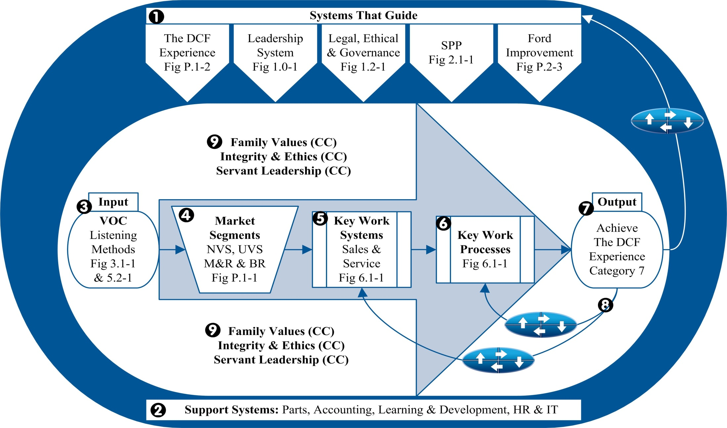
Organizational Excellence Model
Notes:
3-4 cycles of improvement
Stadium chart critical to our sustainability due to it alignment to all the key elements and lazers in on key work systems and work processes
Go from tribal knowledge to sustained performance, talk about Don Passing
Key processes are Processes deployed through pocket cards like those you have been given

Slide 15
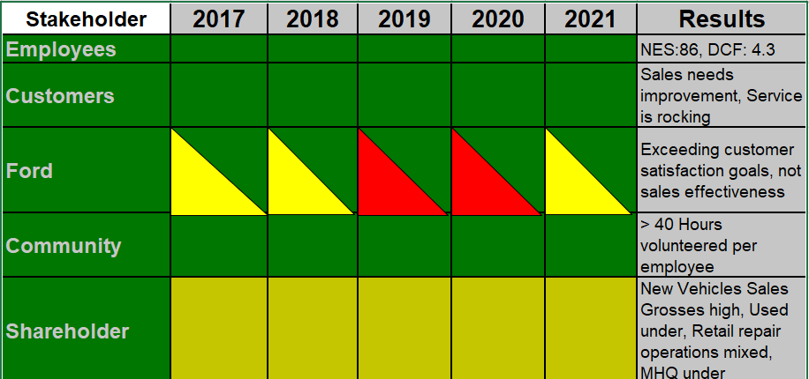
Stakeholder Satisfaction

Slide 16
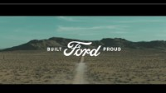
The Future

Slide 17
Post Baldrige
Winning Baldrige was like winning a Super Bowl.
New Challenges – Pandemic, Employees, Vehicles, Parts
Baldrige Criteria is the framework of our QOS
Notes:
However, after the win, there was a large vacuum of energy as we settled back into the regular routines. The learning is that we needed to have new goal line to keep the team engaged. We were late in deploying this goal post.
Baldrige still provides the framework of how we operate our business; we have not abandoned the model. We use our process discipline to hold the line and use the processes.
We thought that the Great Recession was the biggest challenge we would ever have to face in our lifetime! Boy, were we wrong!
In our strategic planning, we never saw the blind spot of not having vehicles to sell or parts to install.
Due to our innovation efforts, we were able to move our sales lead management to an offsite center as the lock downs occurred
We adapted and deployed technology to allow us to sell vehicle touch free.
We trained our workforce to do their work in a non face to face method.
We innovated our payroll software to allow us to add an internal facebook platform to communicate
We launched MS Office for all employees so we could meet with teams and deploy the file sharing tools.
All the while measuring our core measures and tracking the success or the need to make changes.
More challenges - electrification

