Slide 1
Quality New Mexico Leadership Series
Navajo Nation
Economic Development

Slide 2
Navajo Nation Economic Development
Small Business
Development Department

Slide 3
Social Services
Natural Resources
Department of Diné Education
Transportation
Public Safety
Community Development
Health
General Services
Human Resources
Environmental Protection Agency
Department of Justice
Office of the Controller
Economic Development
Navajo Tribal Utility Authority
Navajo Hospitality
Navajo Tax Commission
Navajo Gaming Enterprise
Navajo Oil and Gas
Navajo Shopping Centers
Navajo Arts & Craft
Navajo Engineering and Construction Authority
Diné Development Corporation
Navajo Agricultural Products Industry

Slide 4
Economic Development

Slide 5
Office of the President & Vice-President
Jonathan Nez, President
Division of Economic Development
J.T. Willie, Div. Director
Proj. Dev’t Dept.
Tony Perry
Tourism Dept.
Arval McCabe
Bus. Dev’t Dept.
Elaine Young
Real Estate Dept.
Brenda Jesus
Support Services
VACANT
Bus. Reg. Dept.
Notah Silversmith
Chinle RBDO
Martina Manycows
Eastern RBDO
Jeremy Buckinghorse
Ft. Def. RBDO
Libby Valteau
Shiprock RBDO
Margie Dee
Western RBDO
Edbert Little
Navajo Nation Council
Seth Damon, Speaker
Resource & Community Dev’t Committee
Rickie Nez, Chairperson
5
5
3
4 4 3 4 3
5
21
5
5
7
Notes:
93 Staff, 14 programs and departments

Slide 6
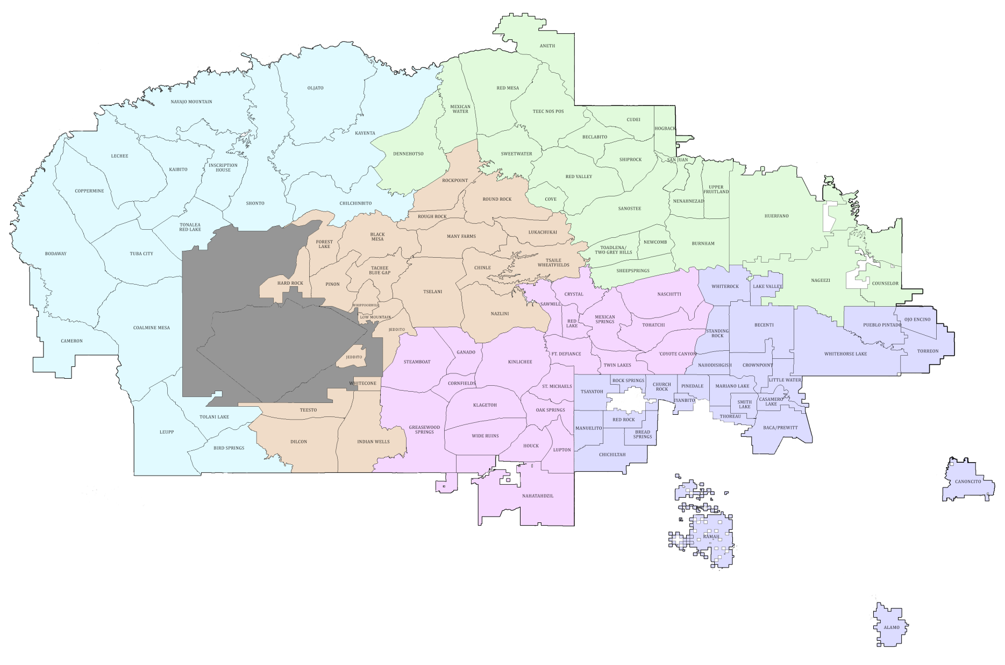
Shiprock
Tuba City
Chinle
Church Rock
St. Michaels
Navajo Nation
RBDO Responsibilities by Chapter

Slide 7
Social Services
Natural Resources
Department of Diné Education
Transportation
Public Safety
Community Development
Health
General Services
Human Resources
Environmental Protection Agency
Department of Justice
Office of the Controller
Economic Development
Navajo Tribal Utility Authority
Navajo Hospitality
Navajo Tax Commission
Navajo Gaming Enterprise
Navajo Oil and Gas
Navajo Shopping Centers
Navajo Arts & Craft
Navajo Engineering and Construction Authority
Diné Development Corporation
Navajo Agricultural Products Industry

Slide 8
Social Services
Natural Resources
Department of Diné Education
Transportation
Public Safety
Community Development
Health
General Services
Human Resources
Environmental Protection Agency
Department of Justice
Office of the Controller
Economic Development
GOVERNMENT PROGRAMS
Navajo Tribal Utility Authority
Navajo Hospitality
Navajo Tax Commission
Navajo Gaming Enterprise
Navajo Oil and Gas
Navajo Shopping Centers
Navajo Arts & Craft
Navajo Engineering and Construction Authority
Diné Development Corporation
Navajo Agricultural Products Industry

Slide 9
1920s
1930s
1940s
1950s
1960s
1922 - Creation of Tribal Business Council
Formed by the Bureau of Indian Affairs, the predecessor of official Navajo self-government. The council had to deal with profits from oil and other mineral resources found on tribal lands.
Precursor to current Navajo Nation Council
Bureau of Indian Affairs oversight of all transactions (economic development projects, land transactions, loans, etc.)
1970s
1980s
1990s
2000s
2010s

Slide 10
1920s
1930s
1940s
1950s
1960s
1970s
1950s and 1960s - Creation of Tribal Business Enterprises
1965 - Office of Navajo Economic Opportunity (ONEO) created
Projects initiated by the administration and Bureau of Indian Affairs. Emphasis on tribal enterprises (NAPI, NCC, NTUA, Shopping Centers, etc.), as tribally-chartered corporations.
1980s
1990s
2000s
2010s

Slide 11
Social Services
Natural Resources
Department of Diné Education
Transportation
Public Safety
Community Development
Health
General Services
Human Resources
Environmental Protection Agency
Department of Justice
Office of the Controller
Economic Development
GOVERNMENT PROGRAMS
Navajo Tribal Utility Authority
Navajo Hospitality
Navajo Tax Commission
Navajo Gaming Enterprise
Navajo Oil and Gas
Navajo Shopping Centers
Navajo Arts & Craft
Navajo Engineering and Construction Authority
Diné Development Corporation
Navajo Agricultural Products Industry

Slide 12
Social Services
Natural Resources
Department of Diné Education
Transportation
Public Safety
Community Development
Health
General Services
Human Resources
Environmental Protection Agency
Department of Justice
Office of the Controller
Economic Development
GOVERNMENT PROGRAMS
TRIBAL ENTERPRISES
Navajo Tribal Utility Authority
Navajo Hospitality
Navajo Tax Commission
Navajo Gaming Enterprise
Navajo Oil and Gas
Navajo Shopping Centers
Navajo Arts & Craft
Navajo Engineering and Construction Authority
Diné Development Corporation
Navajo Agricultural Products Industry

Slide 13
TRIBAL ENTERPRISES
Navajo Tribal Utility Authority
Navajo Hospitality
Navajo Tax Commission
Navajo Gaming Enterprise
Navajo Oil and Gas
Navajo Shopping Centers
Navajo Arts & Craft
Navajo Engineering and Construction Authority
Diné Development Corporation
Navajo Agricultural Products Industry

Slide 14
Enterprise Projects
NTUA
Hospitality
NAPI
NTEC
Solar Projects
Bitcoin Mining
Hotel Development
Exporting
Organics
Coal Mines
Oil & Gas
Navajo Gaming
Diné Development
Corporation
Shopping Centers
Hydrogen
Retail Stores
Casino
Resort
Retail Dev’t

Slide 15
1920s
1930s
1940s
1950s
1960s
1970s
1980s
1990s
1983 Navajo SBA
Navajo Small Business Assistance Department –Navajo Business Development Center
Formed in February 1983 with US Commerce Department's Minority Business Development Agency (MBDA) $170,000 grant from the new MBDA Business Development Center Program
2000s
2010s

Slide 16
1920s
1930s
1940s
1950s
1960s
1970s
1980s
Commission for Accelerating Navajo Development Opportunities (CANDO)
1988 – Health and Human Services grant for $1.25 million to expand CANDO to six regional business development offices (Shiprock, Tuba City, Window Rock/Ft. Defiance, Chinle, Crownpoint, Kayenta)
1990s
2000s
2010s

Slide 17
1920s
1930s
1940s
1950s
1960s
1970s
1980s
RBDO
Renamed “Business Development Department” in the interim Regional Business Development Office (RBDO)”
1990s
2000s
2010s

Slide 18
Shiprock
Tuba City
Chinle
Church Rock
St. Michaels
Navajo Nation
RBDO Responsibilities by Chapter

Slide 19
RBDO Services

Slide 20
RBDO Services
Business Site Leases
Navajo Nation Lending Programs
Business and Industrial Development Fund (BIDF)
Business Technical Assistance

Slide 21
IndianpreneurshipTM A Native American Journey into Business

Slide 22
Indianpreneurship
MARKETING
ORGANIZATION
FINANCE

Slide 23
RBDO Services
Business Site Leases
Navajo Nation Lending Programs
Business and Industrial Development Fund (BIDF)
Business Technical Assistance

Slide 24
Baldrige
“Meaningful Measures and the Baldrige Criteria”

Slide 25
Baldrige – Core Values
Systems perspective
Visionary leadership
Customer-focused excellence
Valuing people
Agility and resilience
Organizational learning
Focus on success and innovation
Management by fact
Societal contributions
Ethics and transparency
Delivering value and results

Slide 26
Baldrige – Systems Prospective
Meaningful Measures
Key Performance Indicators (KPIs)
Dashboards
Category 4, 7.4
Le,T,C,I

Slide 27
CEDS April 2018

Slide 28
MBDA
Keys to Unlocking Business Development in Indian Country
U.S. Department of Commerce
Minority Business Development Agency
https://www.mbda.gov/keys-unlocking-business-development-indian-country

Slide 29
MBDA
Economic Geography
•
Factors for Business Development
Educational Attainment
Internet Infrastructure

Slide 30
MBDA
More Data Needed
Data collection efforts by statistical agencies by reservation needed

Slide 31
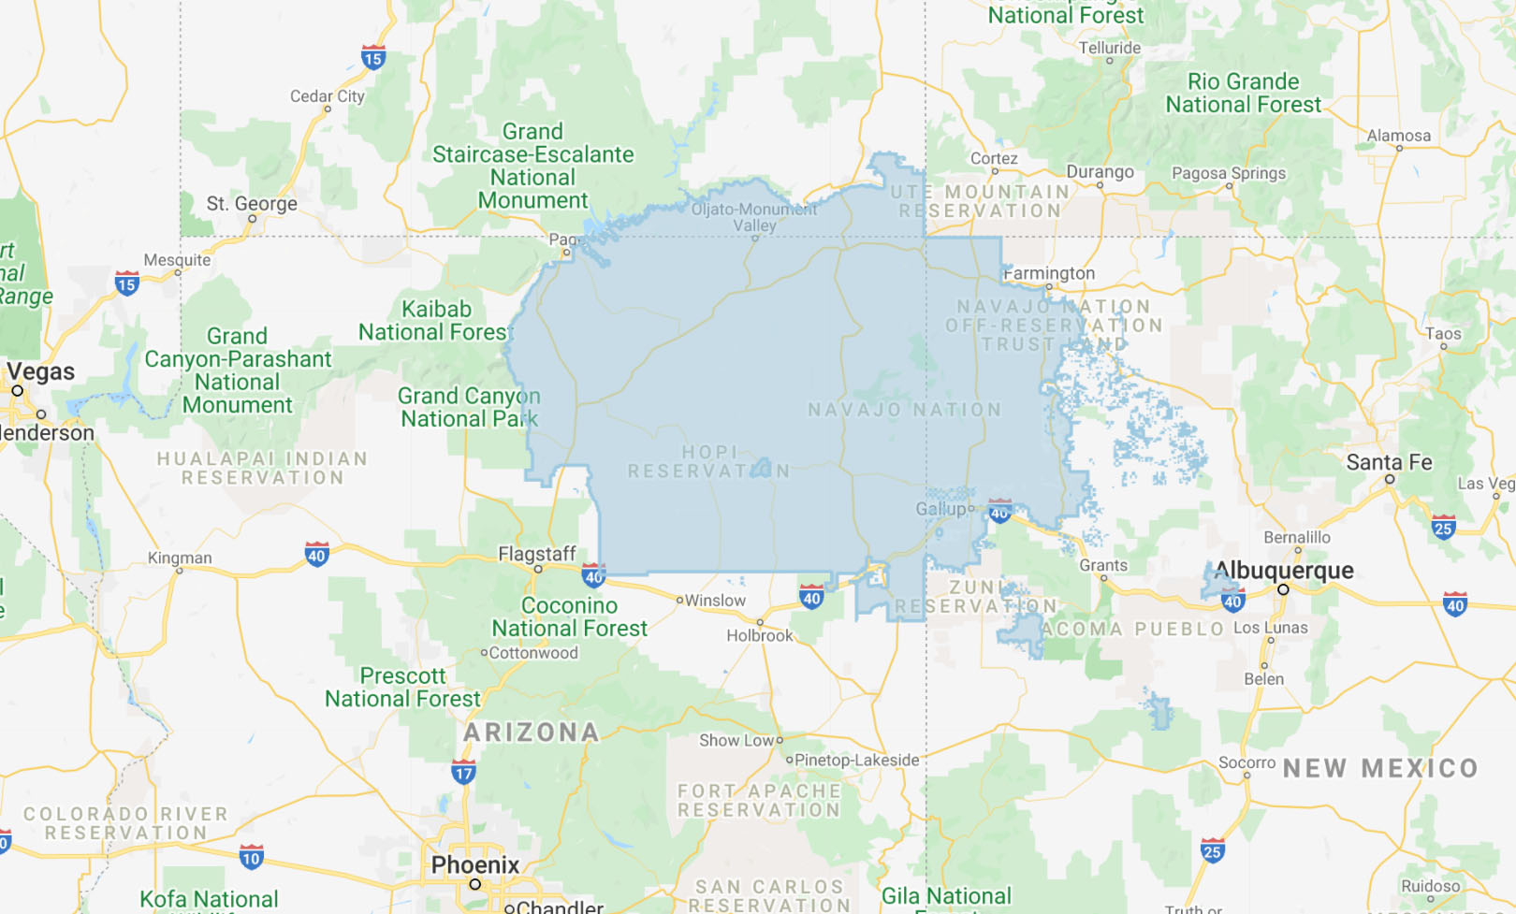

Slide 32
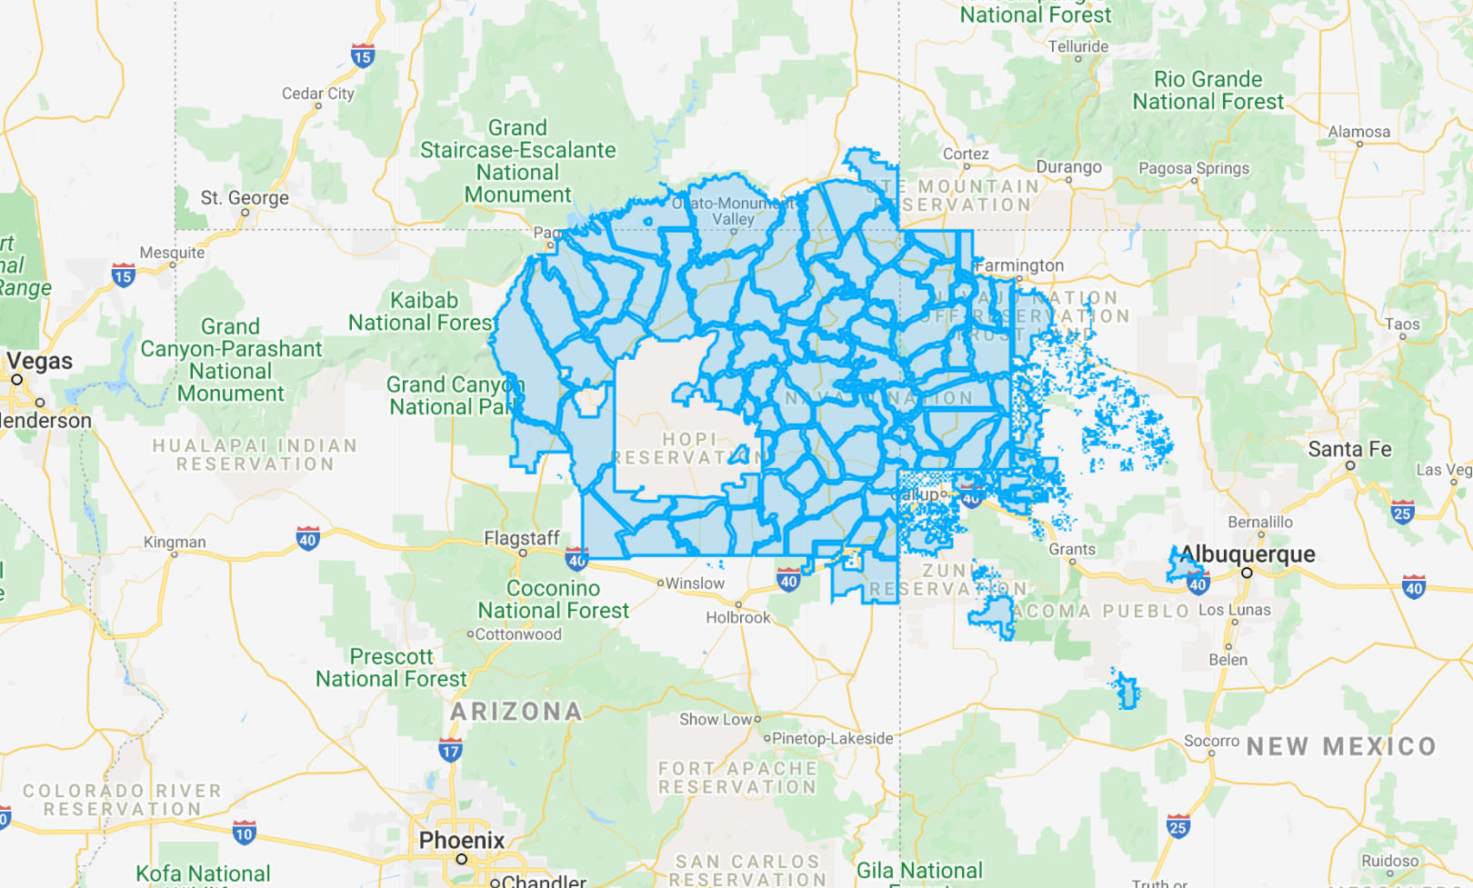

Slide 33
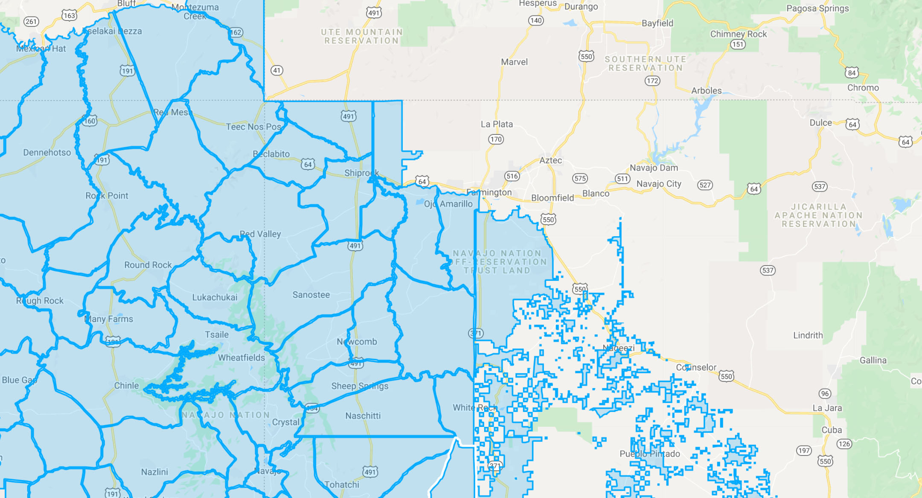

Slide 34
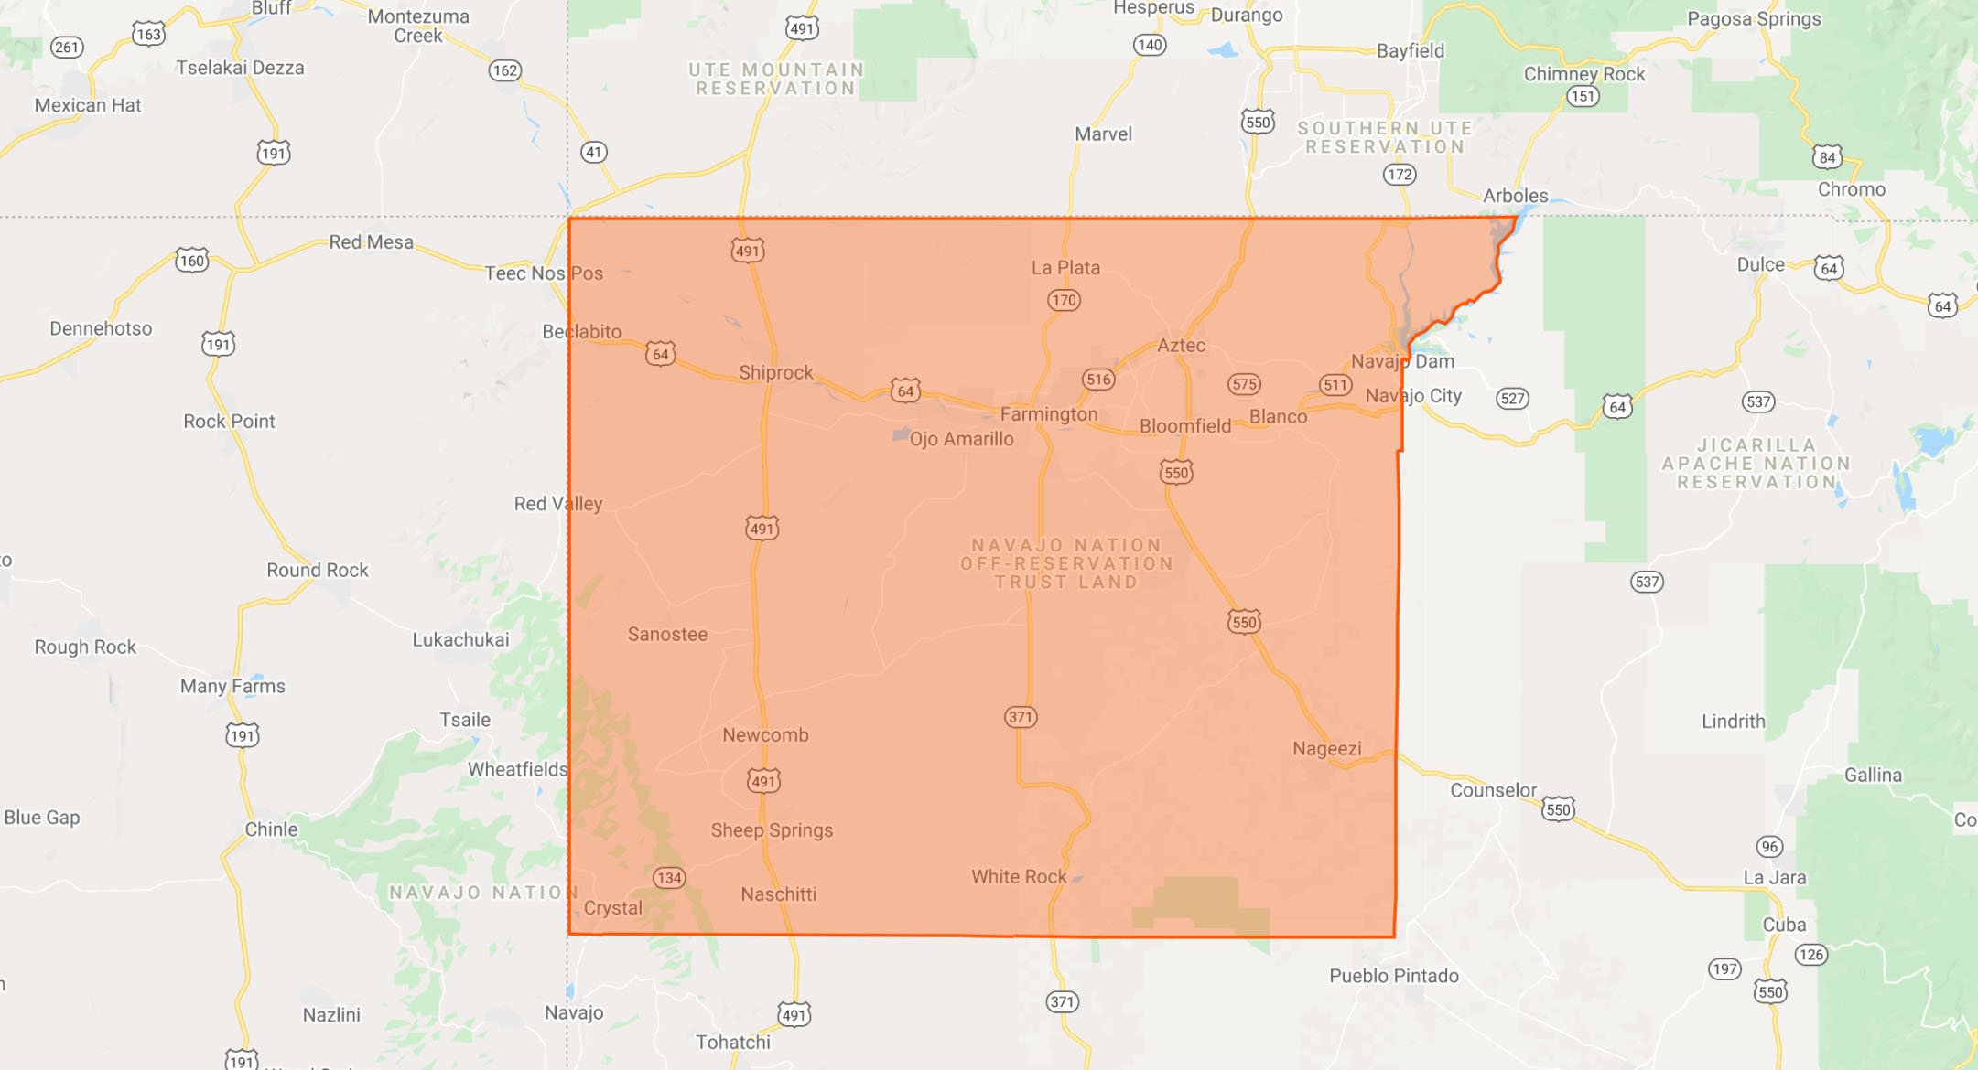

Slide 35
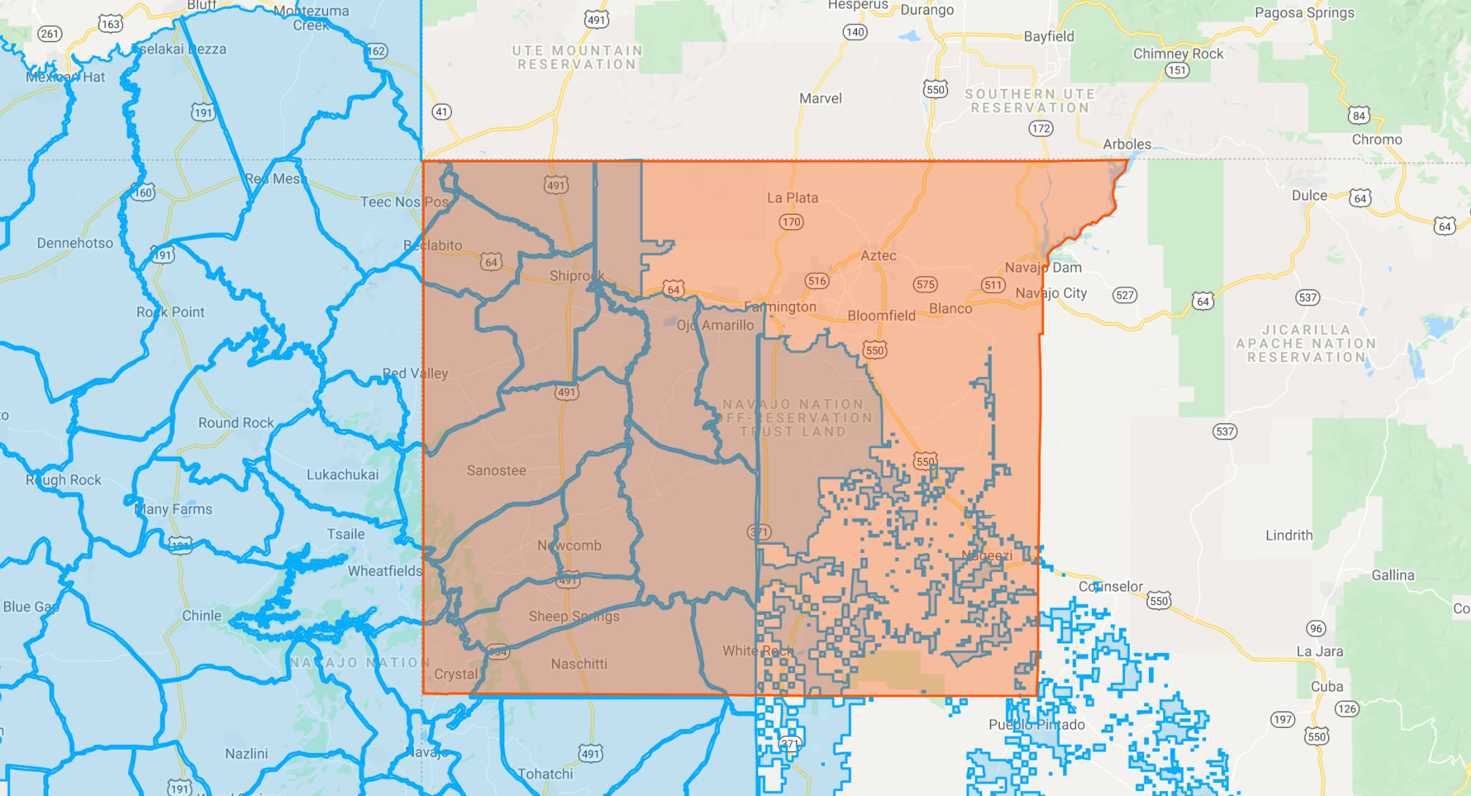

Slide 36
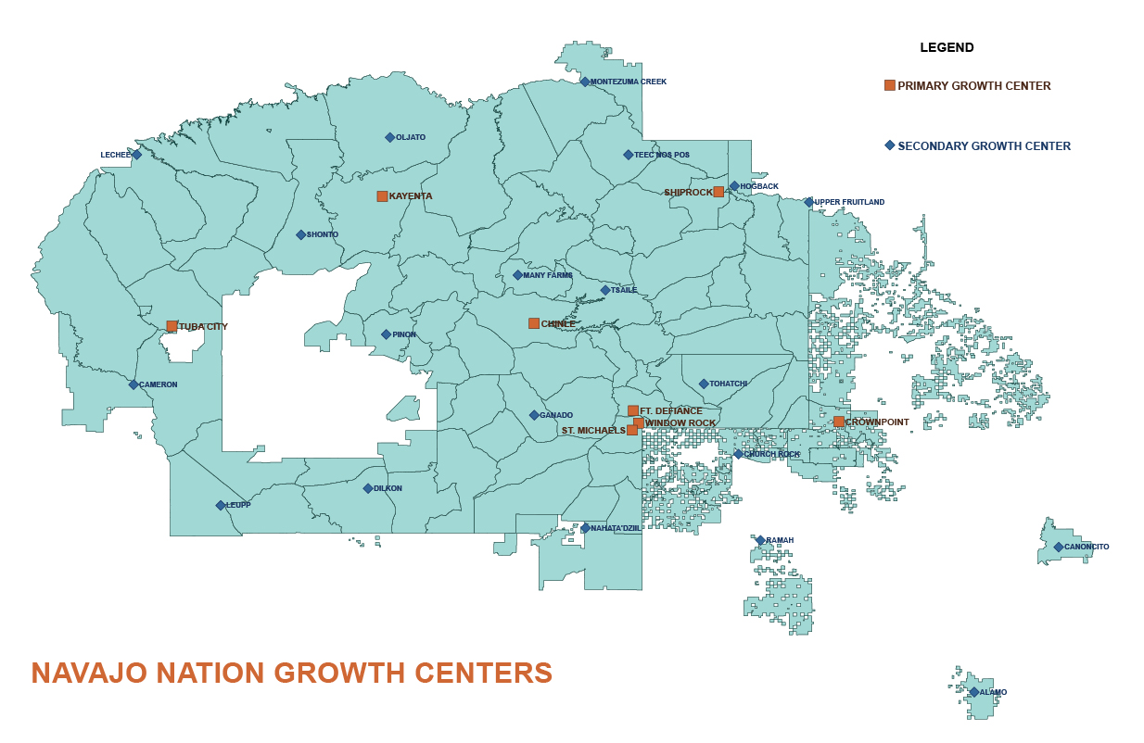
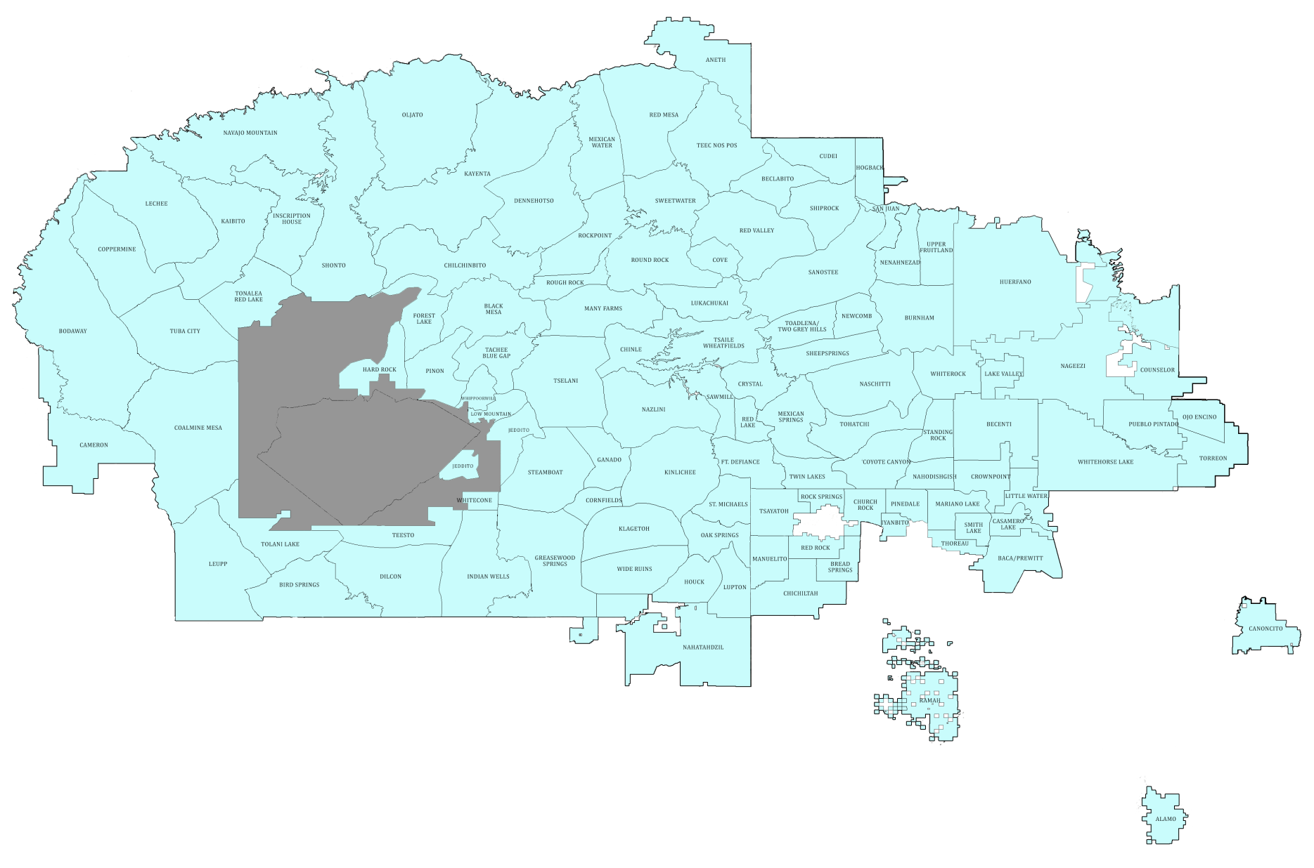
Kayenta
Shiprock
Tuba City
Chinle
Ft. Defiance
St. Michaels/ Window Rock
Crownpoint
Navajo Nation
Primary Growth Centers

Slide 37
Primary Growth Centers
Characteristics
Highest Populations
Major Employers
Highest Employment
Large Housing Developments
Centers of Retail and Service Businesses

Slide 38
Secondary Growth Centers
Characteristics
Secondary Populations Centers
Secondary Employment
High Density Housing Development
Comparable to Satellite Communities or Suburbs

Slide 39
CEDS
https://bit.ly/3Jy4p7v
April 2018
Due for Update in 2022

Slide 42
Communities of Excellence

Slide 43
https://www.youtube.com/channel/UC0aA2Ndpo99BDQ7k2EOzECQ
Search “Navajo Nation Small Business Development Department” on YouTube

Slide 44
Navajo Nation Economic Summit
April 18-21, 2022
Twin Arrows Casino Resort
Flagstaff, Arizona
Website:
nnes.mbmapp.com

Slide 45
Business Plan Competition @ Navajo Nation Economic Summit
Seven Generations
Business Plan
Competition
Center for American Indian Economic Development

Slide 46
Navajo Nation Business Opportunity Day
National Center
for American Indian
Enterprise Development

Slide 47
Rural Export Forum
March 2017
Industries
Manufacturing
E-Commerce
Tourism
2022 Page - Lechee

Slide 48
District Export Council

Slide 49
District Export Councils
59 District Export Councils across the country, 1,500 DEC members nationwide.
Organization of community business leaders with knowledge and expertise in International Business.
Appointed by the U.S. Secretary of Commerce
Volunteer to assist businesses
Liaise with USEAC staff to coordinate export and trade-related activities

Slide 50
USEAC NETWORK ORGANIZATION
05/30/2009
Seattle
Portland
Tacoma
Spokane
Missoula
Fargo
Minneapolis
Boise
Montpelier
Portland
Rochester
Portsmouth
Grand Rapids
NORTHEAST (Boston)
Pontiac
Buffalo
Providence
Sioux Falls
Milwaukee
Detroit
Westchester
Middletown
North Bay/Novato
Ypsilanti
Long Island
Sacramento
Libertyville
Great Lakes (Cleveland)
Harrisburg
New York
Des Moines
Rockford
Toledo
Harlem
San Francisco
Reno
Salt Lake City
Omaha
Midwest (Chicago)
Pittsburgh
Newark
Oakland
San Jose
Peoria
Akron
Trenton
Columbus
Wheeling
MIDATLANTIC (Philadelphia)
PACIFIC NORTH (San Jose/PNW)
SOUTHWEST(Denver)
Kansas City
Indianapolis
Cincinnati
NorthernVirginia
Baltimore
Monterey
Fresno
Las Vegas
Wichita
Lexington
Charleston
Richmond
Bakersfield
St. Louis
Louisville
Greensboro
Ventura County
Downtown LA
Raleigh
West L.A.
Ontario (Inland Empire)
Santa Fe
Tulsa
Nashville`1
Charlotte
Newport Beach
Indio(Cabazon)
Memphis
Knoxville
Oklahoma City
Greenville
Columbia
PACIFIC SOUTH
(So. California)
San Diego
Phoenix
Little Rock
Birmingham
SOUTHERN (Atlanta)
Tucson
Charleston
Ft. Worth
Jackson
Savannah
El Paso
N. Texas/Arlington
Shreveport
Midland
Tallahassee
Jacksonville
Austin
New Orleans
Orlando
Houston
San Antonio
ODO NETWORKS
NORTHEAST
MID-ATLANTIC
SOUTHERN
GREAT LAKES
MIDWEST
SOUTHWEST
PACIFIC NORTH
PACIFIC SOUTH
Clearwater
Ft. Lauderdale
McAllen
Miami
Honolulu
San Juan
Anchorage
(Reports to Pacific South Network)
(Reports to Pacific North Network)
Notes:
There are 109 offices, 8 networks
NFD is Anne Grey
Trade Counseling. Getting US businesses the information and advice needed to succeed.
Market Intelligence. Target the best trade opportunities.
Business Matchmaking. Connecting US business people with the right partners and prospects.
Commercial Diplomacy. Ensure US products and services have the best possible prospects for success in international markets.

Slide 51
SelectUSA – June 2021

Slide 52
SelectUSA – June 2021
Tourism
Navajo
Tourism
Department

Slide 53
SelectUSA – June 2021
Manufacturing
Project
Development
Department
navajoadvantage.com

Slide 54
SelectUSA – June 2021
Retail
Navajo Nation
Shopping Centers

Slide 55
SelectUSA – June 2021
Agriculture
Navajo Agricultural
Products Industry

Slide 56
Thank you
Henry Silentman
Shiprock RBDO
(505) 368-1321
hcsilentman@navajo-nsn.gov
hsilntmn@frontiernet.net

