Slide 1
Gail Hammer, CQA, CMQ/OE, Sr. Quality Advisor
May 18, 2022 ghammer@unmmg.org 505.925.0940
Notes:
Hello and Good Afternoon!
For those of you who don’t know me ….my name is Gail Hammer, I am a 30 year Quality Practitioner, double certified as a Quality Manager and as a Quality Auditor. My first degree was in Behavioral Psychology. I have worked in non-profit, business, government with National Nuclear Security Administration and now 7 years at UNM Health Sciences. Quality principles are the same no matter the business sector.
I currently serve as Health Sciences Sr. Quality Advisor and manage the Health Science Policy Office. In addition, I’ve been involved with quality at the local, state and national level and among other responsibilities, have served many years on the state Panel of Judges for the state Baldrige Award process.
Delighted to be with you all this afternoon and thank you for taking time to think about a career in Quality.

Slide 2
Why practice Quality?
Quality is free. It’s not a gift, but it’s free. The “unquality” things are what costs money. –Philip Crosby
WARNING: Practicing quality can lead to high performance.
Notes:
First a plug for the wonderful world of Quality.
Not only is practicing quality the right thing to do and the intelligent thing to do, it is often the required thing to do!
So understanding quality is fundamental to performance.

Slide 3
Grow your Quality Career
Commonly, a quality career begins with a simple interest and it evolves into a lifelong passion.
Notes:
So let’s dive into quality - as a career.
Like many young people, during and soon after college I had a couple different jobs and having just graduated with a degree in Behavioral Psychology, I began to see a similar patterns of behavior at the various places I worked. Front line employees would see things very differently than those in operations and finance.
First-hand Examples - waitresses to management or sales people to finance executives or claims such as…the I worked for organization who said- Customer comes First.. But then didn’t care that customers were put on hold for long periods of time.
There always seemed to be a rub or a chasm between the groups of people. When I began to read about TQM taking hold in America in the 1990s, I attended a few workshops, and low and behold- they talked about that gap, those chasms I saw, and how practicing quality principles eliminated the situation in high performing companies. With that I was hooked- it opened up a whole new world to me.

Slide 4
Many opportunities to practice Quality
Analysts
Auditors of all types
Certified Suppliers
Process Improvement Specialists
Process Engineers
Inspectors
Project Managers
Quality Directors
Quality Consultants
Quality Leaders
Quality Trainers
Reliability Managers
Risk Managers
Notes:
As I learned more… I learned that Quality is expansive and there are literally dozens and dozens of ways to support the profession. Back then there were no college degrees in Quality, so I attended every seminar and conference I could and eventually found myself in a Quality Director’s role. At that point I decided I better become certified and took two separate 5-hour exams to become double certified in 2003, almost 20 years ago.

Slide 5
Education in Quality
Colleges offer Degrees that include Quality Management
MBA
Operation Management
Business Sector Organizations offer certificates
Institute for Healthcare Improvement
Excellence in Learning
World Class Manufacturing
Consultants, Non-Profits and Coaches offer training
In every methodology
National Baldrige Program
National Performance Excellence Framework
New Mexico Professional Groups
Notes:
Today, you can gain all sorts of quality degrees, certifications and experience!
A fast google search shows available MBAs in Quality Management from around the globe- Spain, India, United Emirates, Puerto Rico and most states and colleges in America. Many now specializing in areas of expertise, such as Quality engineering or healthcare quality etc.
In New Mexico we have three groups that educate…

Slide 6
In New Mexico
Notes:
You can begin to learn about the area of interest starting right here in New Mexico!
Each of the three organziations can serve an important role in a quality professional's career.

Slide 7
ASQ offers18 Opportunities to become Certified
In the country
Calibration Technician
Manager of Quality and Organizational Excellence
Supplier Quality Professional
Quality Improvement Associate
Quality Inspector
Quality Process Analyst
Quality Technician
Food Safety and Quality Auditor
Medical Device Auditor
Pharmaceutical GMP Professional
Quality Auditor
Quality Engineer
Reliability Engineer
Software Quality Engineer
Six Sigma: Master Black Belt, Black Belt, Green Belt, Yellow Belt
Notes:
ASQ originally stood for the American Society for Quality, however ASQ is now a global organization.
ASQ provides training, certifications to members from over 130 countries, with offices in Milwaukee, Wisconsin, Mexico, India and China.
ASQ’s mission is to achieve excellence through quality.
I am a Sr. Member of ASQ.

Slide 8
International Organization For Standardization Offers Numerous Certifications with Unlimited Opportunities!
In the world
ISO 9001:2015 Certified
Quality Management Systems
ISO 14001:2015 Certified
Environmental Management Systems
ISO/IEC 27001:2013 Certified
Information Technology
https://www.iso.org/standards.html
2 minute video
Notes:
ISO is an independent, non-governmental international organization with a membership of 167 countries ( one member per country national standards bodies. There are over 800 technical committees and subcommittees who develop the standards

Slide 9
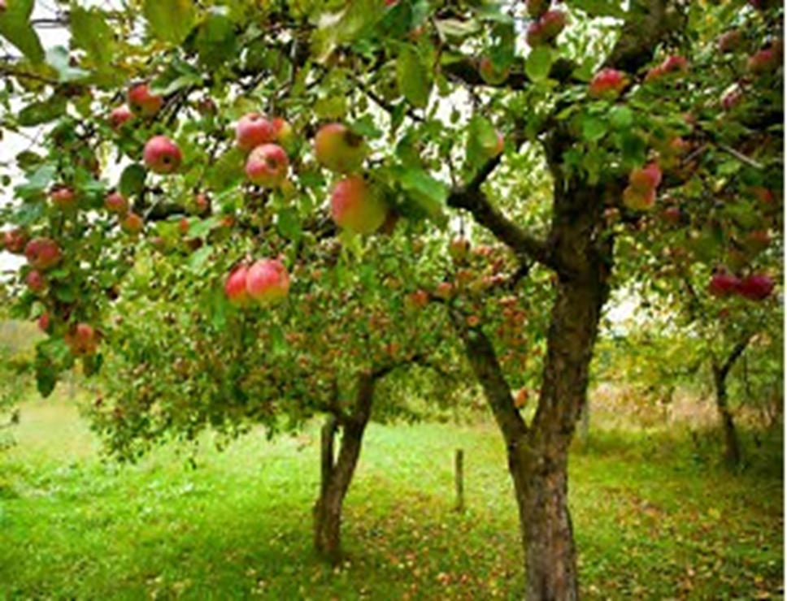
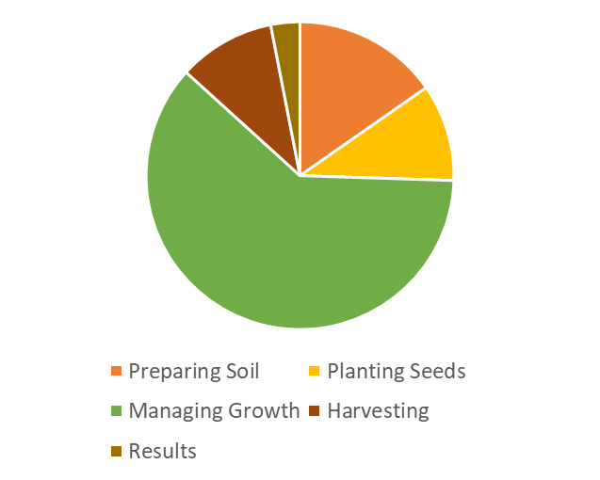
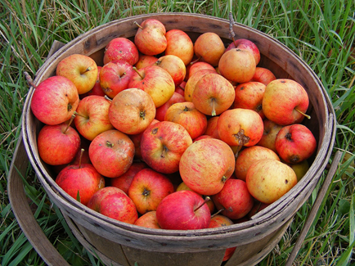
Performance Excellence
= The Long View
Prepare soil
Plant seeds
Manage the project
Nutrients, Water, Bees
Bug Control
Sunshine, Warmth
Pruning, Picking
Sharing, Eating
Output
Notes:
A career is the long view, right?
Where is the most energy spent? Managing growth. It’s the same whether you are nurturing an apple tree or a career. You’ve had an education, the seeds are planted now all the aspects of managing a career kick in to achieve the results you are looking for.

Slide 10
As a Quality Professional - we manage our own growth
- We must understand what organizational excellence looks like; The Big Q!
- We must be inclusive and work to gather input from all stakeholders and use that input to improve.
- We must believe in the long view- becoming better and better over time, so process maturity, sustainability and organizational advancements can take place.
- We must be proactive, engaged, and enjoy learning and leading change.
Promoting excellence is a worthy and rewarding career and is especially exciting when people work together to achieve goals that were only a dream when they began.
Success is finding something you really like to do and caring enough about it to do it well.
Malcolm Baldrige
Notes:
Choosing a quality profession is a rewarding career! You work hard, and can enjoy the pride and joy it brings to all.

Slide 11
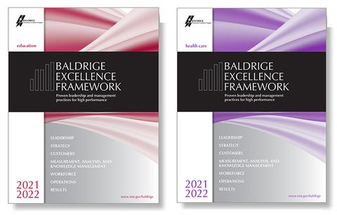
Organizational Excellence
The Baldrige Framework – a systematic approach
The Baldrige Criteria – seven categories for organizational excellence
The Baldrige’ most important product is - The Feedback Report
Notes:
The tools are available…
Overall components of excellence are best documented in the national Baldrige framework for Performance Excellence and in ISO Standards.
Let’s talk a bit about the Baldrige Excellence Framework

Slide 12
Seven Categories The Heart of Baldrige
First- Organizational Profile
Leadership
Strategy
Customers
Measurement, Analysis & Knowledge Management
Workforce
Operations
Results
Notes:
Categories 1-6 and the systems that support them are interconnected and the results in Cat 7 reflect how well the systems in 1-6 are doing.
This framework can be applied to any organization, whether you serve on a Board of Directors, church committee Coach a little league team….it is amazing how knowing the framework can help structure better systems.

Slide 13
11 Core Values and Concepts
Systems Perspective
Visionary Leadership
Customer- (or Patient-, or Student-) Focused Excellence
Valuing People
Agility and Resilience
Organizational Learning
Focus on Success and Innovation
Management by Fact
Societal Contributions
Ethics and Transparency
Delivering Value and Results
Best way to learn about these categories and concepts?
Notes:
The Baldrige framework teaches us about the broad scope of quality. The interconnectivity that drives high performance

Slide 14
Become a state or national Baldrige Examiner!
A Examiner is an individual who helps drive organizational performance excellence.
They do this by using the Baldrige framework to study, analyze and evaluate an organizational application in a team setting.
Examiners write the Feedback Report; which is a key reason organizations apply for state/national Baldrige award.
Ethical Codes of Conduct are strictly observed
Training is provided by QNM or the Baldrige Program. You will learn about the Baldrige Excellence Framework, and how to write comments for the Feedback Report. You will also learn much more!
Notes:
The best way to learn about the framework is to become a Baldrige examiner either on the state or national level.

Slide 15
How does becoming an Examiner help YOU?
YOU
Enhances quality knowledge through expert examiner training and the examiner process
Builds your career - Receive Recognition
Builds a network of quality-minded friends
Builds your reputation as Ambassador for quality improvement
Improves your analytical, team building and consensus skills
Improves your oral and written communication
Opens doors and conversations
Expands your view of quality improvement
Keeps your brain sharp
Strengthens your ability to apply the performance excellence concepts within your organization
Improves your understanding of systems

Slide 16
How does becoming an Examiner help your organization?
YOUR ORGANIZATION
The more individuals that understand performance–based management the better an organization can accelerate improvement
When employees are engaged it energizes improvement efforts and reduces turnover
Gains perspective – learn from the best
Uses a systematic approach - generating improved results
Learning opportunities from expert feedback
Helps leaders prioritize and focus on what is most important
Helps outperform the competition

Slide 17
Join ASQ and live by their Code of Ethics
A. Act with Integrity and Honesty
Strive to uphold and advance the integrity, honor, and dignity of the Quality profession.
Be truthful and transparent in all professional interactions and activities.
Execute professional responsibilities and make decisions in an objective, factual, and fully informed manner.
Accurately represent and do not mislead others regarding professional qualifications, including education, titles, affiliations, and certifications.
Offer services, provide advice, and undertake assignments only in your areas of competence, expertise, and training.
B. Demonstrate Responsibility, Respect, and Fairness
Hold paramount the safety, health, and welfare of individuals, the public, and the environment.
Avoid conduct that unjustly harms or threatens the reputation of the Society, its members, or the Quality profession.
Do not intentionally cause harm to others through words or deeds. Treat others fairly, courteously, with dignity, and without prejudice or discrimination.
Act and conduct business in a professional and socially responsible manner.
Allow diversity in the opinions and personal lives of others.
C. Safeguard Proprietary Information and Avoid Conflicts of Interest
Ensure the protection and integrity of confidential information.
Do not use confidential information for personal gain.
Fully disclose and avoid any real or perceived conflicts of interest that could reasonably impair objectivity or independence in the service of clients, customers, employers, or the Society.
Give credit where it is due.
Do not plagiarize. Do not use the intellectual property of others without permission. Document the permission as it is obtained.
Notes:
Next piece of advice is to join a quality organization
Join ASQ and live by the Code!
Or Join Quality New Mexico or join Albuquerque Quality Network. Any of the three will help you along your quality career.

Slide 18
Join Quality New Mexico
And become a state Examiner

Slide 19
Join Albuquerque Quality Network
And register to participate in their AQN / UNM Certificate Program. 4 levels from Competency to Mastery. Each level involves attending 8 seminars.

Slide 20
Learn and practice a Quality principle each month Read a quality book or magazine
Read the Classics:
Quality is Free
Out of Crisis
Quality without Tears
Good to Great, Built to Last
Juran’s Quality Handbook
Leading Change
7 Habits of Highly Effective People
Read the Basics:
Process Quality Control
Statistical Thinking
Understanding Variation
The Essential Deming
Lean Six Sigma Techniques
The Balanced Scorecard
Make it a habit
https://asq.org/blog/2020/01/the-15-quality-books-you-should-be-reading
Notes:
Here are just a few of the many quality principles to learn about ….

Slide 21
Quality Principle: Manage the cause, not the result.
“Managing by results is like looking in the rear-view mirror.”
Notes:
Working on Pressure injury rate…Working on an outcome? No, rather working on the processes that will result in a lower injury rate.

Slide 22
Quality Principle:
Use Best Practices, don’t reinvent the wheel!
Notes:
Always remember to use best practices whenever possible, but don’t shy away from innovation.

Slide 23
Quality Principle:
Progress can not occur without change; Change cannot occur without action.
Darwin: “It is not the strongest species that survive, nor the most intelligent, but the ones most responsive to change.”
Einstein: “We cannot solve our problems with the same thinking we used to create them.”
Me: Quality is about taking action; be it starting, stopping, changing or improving. No action=status quo.

Slide 24
Quality Principle:
Build quality in!
Focus on performance-based process management
Put resources into process rigor and process compliance to achieve performance excellence, rather than depending on audits to remove waste.
Use Resources: Brainpower, expertise, time in collaboration with those who do the job, pilot.
Add Rigor: Build for risk, make it lean, (efficient/effective) use a scientific approach.
Ensure Compliance: Understand, train, access, improve.
Resources
Rigor
Compliance

Slide 25
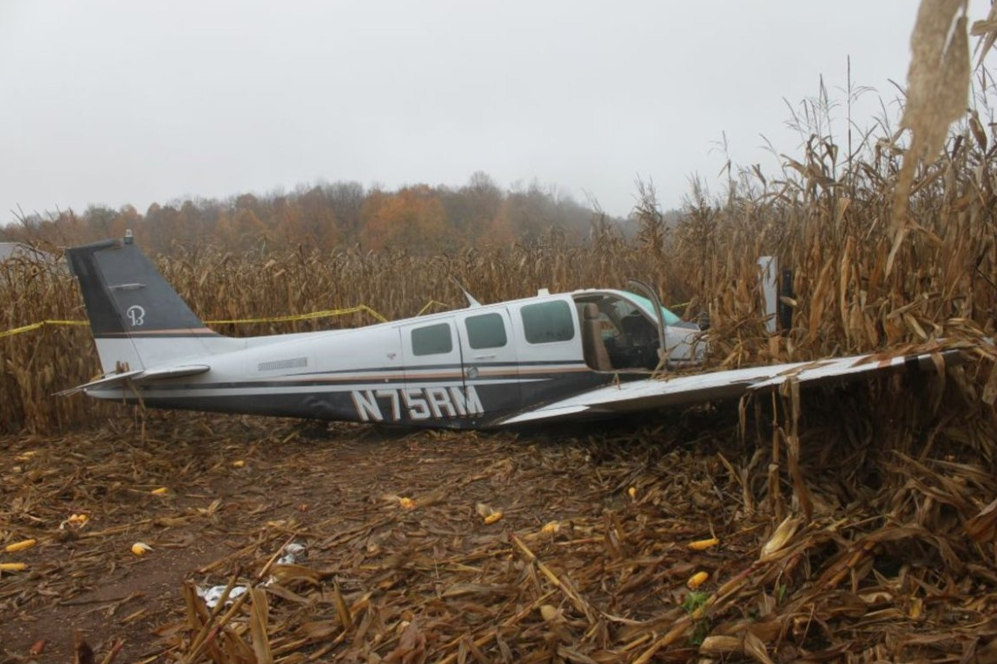
Quality Principle: The further a defect gets into the process, the more it costs to fix it.
Notes:
Wrong med- Clinical world

Slide 26
Quality Principle:
What gets measured gets done.

Slide 27
To advance your career…
Be pro-active – apply quality concepts in all you do
Join a quality-based group
Get credentialed
Continually read, learn and study the principles of quality
Teach others the goodness of quality
Encourage your organization to build quality systems
Live by a Code of Ethics
Serve a community separate from your organization using quality fundamentals.
Help others be successful; their success is your success.
Search for best practices and innovative solutions
Give credit and recognition to those doing good work
Be adventuresome, be curious, be innovative, be friendly, be polite, be fact-based, be courageous, be honest, be respectful, be professional, be inclusive, and be ethical.

Slide 28
In Summary…
Turn on your love of quality♥ because the power to achieve high performance is in always a good thing for us all!
Thank you!
You cannot practice quality without taking action.

Slide 29
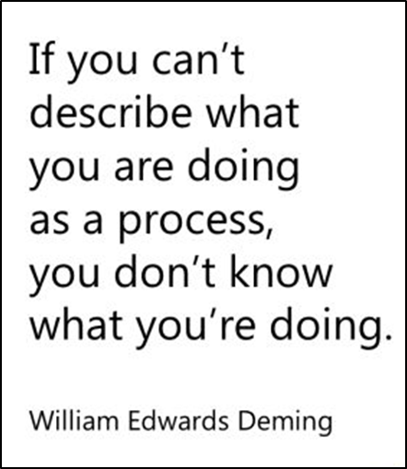
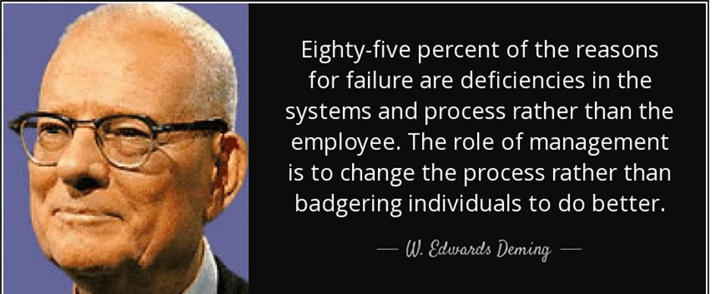
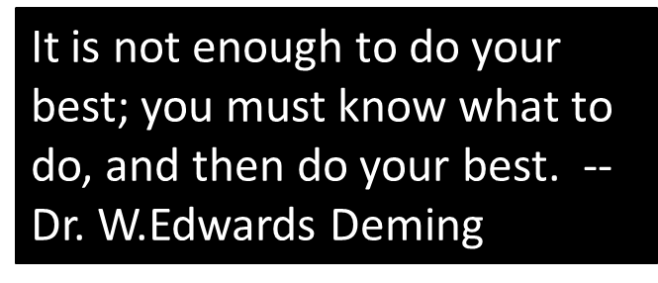
Money and time spent for training will be ineffective unless inhibitors to good work are removed. - Deming
Notes:
Favorite quotes from Deming…

Slide 30
Some favorite quotes to inspire.
Out of clutter, find simplicity, from discord, find harmony, in the middle of difficulty lies opportunity. – Albert Einstein
In times of change, learners inherit the earth while the learned are adapted for a world that no longer exists. – Eric Hoffer
You cannot escape the responsibility of tomorrow by evading it today. – Abraham Lincoln
Persistence is what makes the impossible possible and the possible likely and the likely definite. - Robert Half
Standardization is not meant to stifle innovation or subvert progress. Quite the opposite, it is intended to remove variation in processes, which can cause failure, poor performance and disagreements or friction between parties. – Dale Gordon Director of Quality Rolls Royce North America
Coming together is a beginning. Keeping together is progress. Working together is success. --Henry Ford
Never doubt that a small group of thoughtful, committed citizens can change the world; Indeed, that is the only thing that ever has. Margaret Mead
Success is never final; failure is never fatal. It’s courage that counts. – Coach John Wooden
Courage is being scared to death, but saddling up anyway. – John Wayne
Good is the enemy of great. – Jim Collins
Always ask what went wrong, not who. – Anonymous
Pity isn’t for me and every trail has puddles. – Anonymous
The illiterate of the future are not those who cannot read and write, but those who cannot learn, unlearn and relearn. – Alvin Toffler
If you don’t have time to do it right, when will you have time to do it over?- John Wooden
Quality is about always improving to be your best; begin with yourself. - Gail Hammer
Are we doing the right things? Are we doing things right? Quality is the connectivity between the two. - Gail Hammer
Notes:
More favorite quotes

