Slide 1
Continuing the Journey
The Challenges & Successes
Maureen Baca President Board of Directors
QNM Leadership Series January 19, 2022

Slide 2
Let’s Be Interactive
Ask questions of clarification any time

Slide 3
At the End of this Session You Will:
Learn why we continue & what we do to continue
See how we reinforce the journey
Discover how we measure progress
Identify your own reasons to achieve excellence

Slide 4
Who is the NMPhil?

Slide 5
Vision
As a world-class orchestra, the New Mexico Philharmonic aspires to increase the economic and cultural vitality of the state and gain national and international recognition for its excellence.

Slide 6
Mission
The New Mexico Philharmonic enriches lives by providing excellent music, community engagement, and educational opportunities.

Slide 7
Our Values
Excellence in all our practices
Responsibility in all our actions
Service to all our communities
Centered around our musicians and our patrons

Slide 8
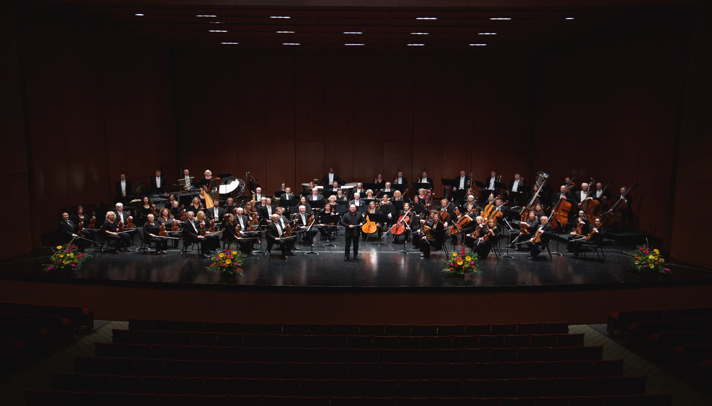
The Heart of the NMPhil

Slide 9
NMPhil Details
New Mexico’s major professional orchestra
75 professional, conservatory-trained musicians
6 full-time staff
60 guild members
501c3 — new in May 2011
First concert December 2011
Now in our 11th year and 10th season

Slide 10
$2,300,000 Budget
A Few More Context-setting Facts:
$1.15 Million earned $1.15 Million donated

Slide 11
Principle Products:
24 Orchestral Concerts UNM Popejoy Hall, Immanuel Presbyterian Church, ABQ Zoo, Rio Rancho Sky Room — Reaching 40,000+
3 Education Programs 15 Youth concerts including Symphony for Autism; In-School Ensemble Visits; Young Musician Initiative — Serving 20,000

Slide 12
Why Continuing the Journey is important to us

Slide 13
We Continue the Journey because:
Impact: make things as easy & effective as possible
Long term results: classical music here permanently
Stakeholders: “NMPhil knows how to manage”
Recognition: Awards help tell our story

Slide 14
What We Do To Continue
Leadership Focused on the Future
Systematic Strategic Planning
Management by Fact: measure and act
“All work is a process”
After Action Reviews: every significant event
Cycles of Improvement: regularly review & improve

Slide 15
How NMPhil Reinforces the Journey

Slide 16
Reinforcing Journey
Develop new skills in the staff
Generate new awareness & support from the Board
Engage more community members & leaders
Improve and reinforce “management by fact”

Slide 17
With Stakeholders
Transparency: our methods & results
Especially financials
Public Events: utilize every significant event
Concert stage
Newsletters
Receptions
One on One: our story, our results

Slide 18
How NMPhil Measure our Progress

Slide 19
Tracking Results
From our start . . .
Financials
Concert Attendance
Education Programs
Participation numbers
Academic impact

Slide 20
Key Areas to Measure
Our concert audiences – “key customers”
6 Segments
Satisfaction & Dissatisfaction
Our education programs – attendance & academics & behaviors

Slide 21
Key Areas to Measure
Key business processes, factors
Subscriptions
Venue utilization
Board effectiveness
Suppliers
Workforce – staff, musicians, volunteers
Strategy Implementation

Slide 22
Methods in Measurement
Surveys, comprehensive data collection & analysis
Net Promoter Scores – best in class
Best in class orchestra comparisons
Local comparisons where available

Slide 23
Milestones with NMPEA
2014
2016
2017
Piñón
Piñón
Road Runner
First QNM application
Second QNM application
Third QNM application

Slide 24
The Big Why We Continue

Slide 25
The Why
We are all proud to say we are process based
Extremely important to a small organization with very limited resources
We leverage what we do, we make no mistake twice, we learn from each other
We continue to move from being dependent on individuals to relying on our processes

Slide 26
Plan or Continue Your Journey

Slide 27
In Small Groups
Introductions –– pick a reporter
If you have “won” or are on the Journey — what you do to continue
If you have not — record what you would like to do to start your journey
Plan for your journey
Identify team
Develop timeline
Identify your outcomes / measures / results

Slide 28
Our message to you:
If NMPhil, a small arts organization, is continuing to grow & improve using Baldrige / QNM / NMPEA
So can any organization!

Slide 29
Join the Journey!

Slide 30
Thank you!
Questions?

